Slide 1
CRICVISION-MULTIMODAL CRICKET VIDEO SEGMENTATION AND RETRIEVAL BY PLAYER IDENTITY AND EVENT TYPE
25-26J-148

Slide 2

IT22141606 | RATHNAYAKE R.M.N.D
MULTIMODAL CRICKET VIDEO SEGMENTATION AND RETRIEVAL BY PLAYER IDENTITY AND EVENT TYPE
My component focuses on identifying player names and roles from the scoreboard, associating players with detected cricket events, and enabling player-wise retrieval through the dashboard.
IT22141606 | RATHNAYAKE R.M.N.D | 25-26J-148

Slide 3
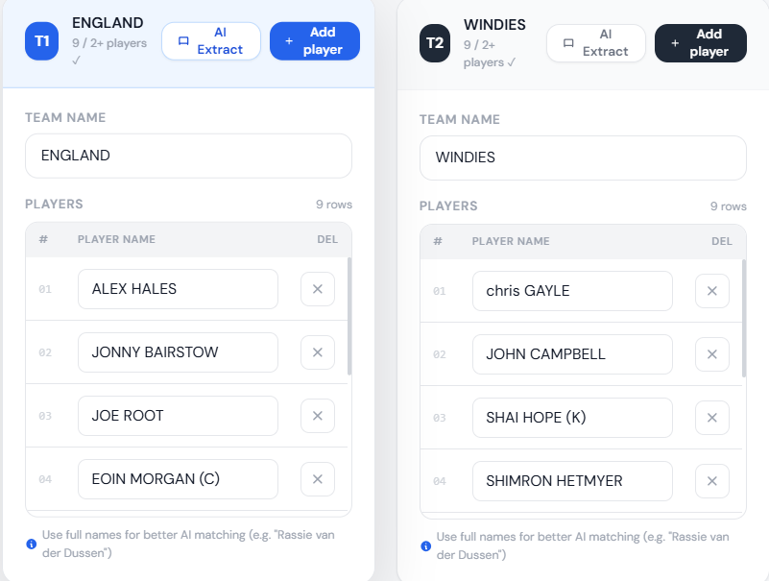
MULTIMODAL CRICKET VIDEO SEGMENTATION AND RETRIEVAL BY PLAYER IDENTITY AND EVENT TYPE
PP2 comments
It is better to automate the player dictionary creation rather than filling a form manually.
Action Taken
Automated player name typing by allowing the user to upload a player-list image.
The system extracts team name and player names automatically using OCR and fills the form automatically.
IT22141606 | RATHNAYAKE R.M.N.D | 25-26J-148

Slide 4
MULTIMODAL CRICKET VIDEO SEGMENTATION AND RETRIEVAL BY PLAYER IDENTITY AND EVENT TYPE
Problem & Its Impact
Cricket videos are long, and manually finding player-specific events such as boundaries, wickets, batsman changes, or bowler spells is time-consuming
Overall Solution
The system processes uploaded cricket videos and creates timestamp-based player-event segments automatically.
Design Excellence
It combines scoreboard OCR, player role extraction, umpire signal classification, timestamp synchronization, and an interactive dashboard for direct video navigation.
IT22141606 | RATHNAYAKE R.M.N.D | 25-26J-148

Slide 5
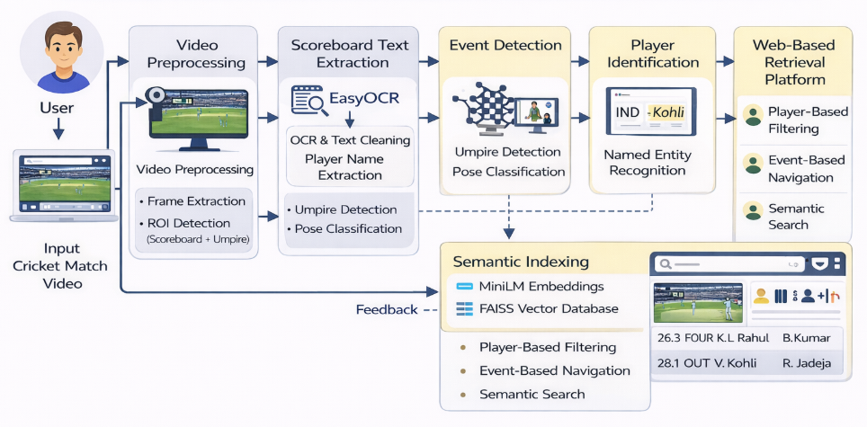
MULTIMODAL CRICKET VIDEO SEGMENTATION AND RETRIEVAL BY PLAYER IDENTITY AND EVENT TYPE
High level Architecture
IT22141606 | RATHNAYAKE R.M.N.D | 25-26J-148

Slide 6
MULTIMODAL CRICKET VIDEO SEGMENTATION AND RETRIEVAL BY PLAYER IDENTITY AND EVENT TYPE
Overall System Workflow
1. User uploads match video with team/player details or extracts players from a lineup image.
2. Backend samples video frames and extracts scoreboard text using EasyOCR.
3. Player names are cleaned, matched with roster data, and assigned as batsman 1, batsman 2, and bowler.
4. Umpire detection and pose classification identify FOUR, SIX, WICKET, and NO-ACTION moments.
5. Events are synchronized with nearest scoreboard frames to build player-event records.
6. Dashboard displays timeline, player search, wicket attribution, transcript, and video jump links.
IT22141606 | RATHNAYAKE R.M.N.D | 25-26J-148

Slide 7
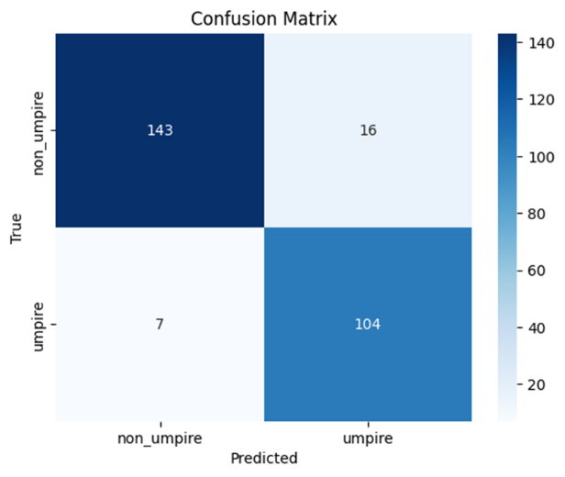
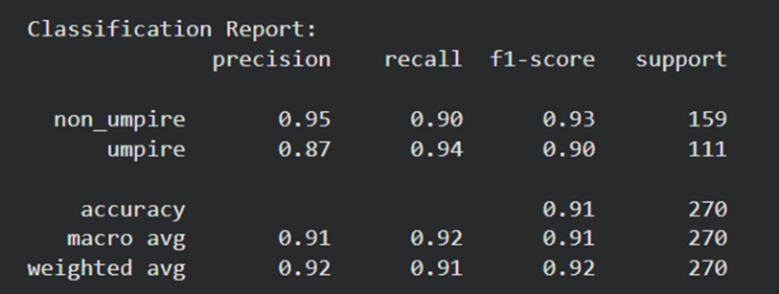
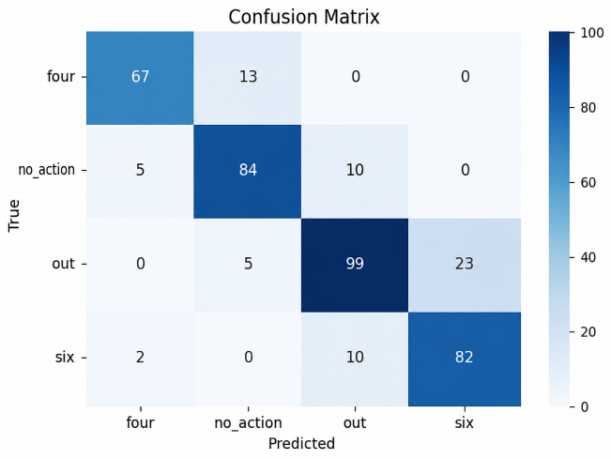
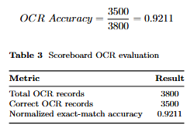
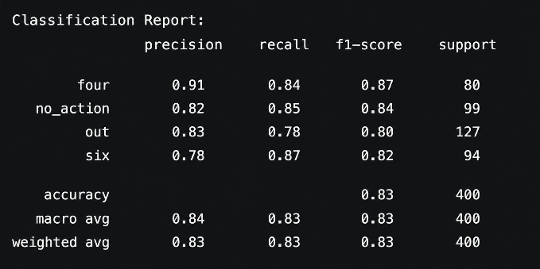
MULTIMODAL CRICKET VIDEO SEGMENTATION AND RETRIEVAL BY PLAYER IDENTITY AND EVENT TYPE
Models and Evaluation Matrices
EfficientNet-B0 →for umpire detection
2. ResNet-18 →for umpire pose classification
3.OCR →for Player name extraction
IT22141606 | RATHNAYAKE R.M.N.D | 25-26J-148

Slide 8
Feedback from Users /User Acceptance Test

